Slide 1

Digital Preservation: Local Problems, Networked Solutions
Lisa Goddard
AUL Digital Scholarship
University of Victoria Libraries
PRRLA 2019, Seoul

Slide 2







Digital Preservation Partnerships
NATIONAL
CAMPUS
REGIONAL
Notes:
Digital preservation is necessarily a collaborative activity. I’ll talk a little bit about our local efforts at UVic libraries, and about the campus, regional, and national partnerships that make our work possible.

Slide 3
Canadian Association of Research Libraries (CARL)
Notes:
In 2018 CARL surveyed 26 of Canada’s major research libraries about their DP readiness. Results were mixed.
http://www.carl-abrc.ca/wp-content/uploads/2018/12/CARL-DPWG-Survey-Phase1Report.pdf
http://www.carl-abrc.ca/wp-content/uploads/2018/12/CARL-DPWG-Survey-Phase2-Report.pdf
Results indicate that there is a broad commitment to digital preservation across organizations, though most cited that this
commitment has not translated into resources for program development.

Slide 4
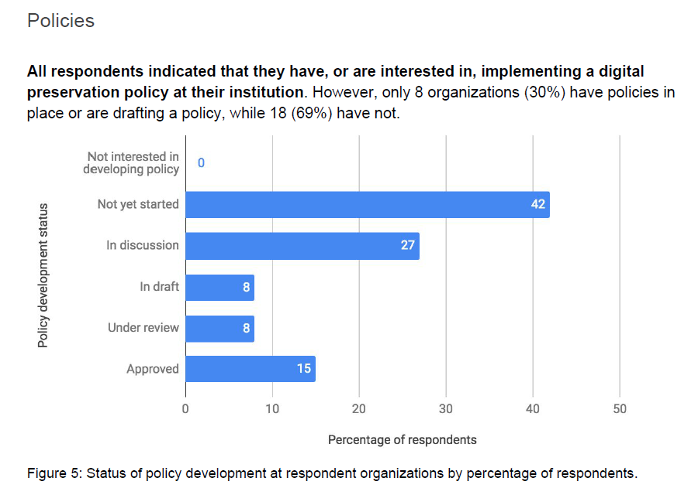
Notes:
One of the most striking results showed that only 8 of 26 institutions had a digital preservation policy in place.
DP policy is critical to articulate institutional priorities, and also to provide librarians with guidance on the kinds of promises that we can make to our faculty and donors.

Slide 5
Notes:
Happy to say that UVic Libraries do have a preservation framework online, largely thanks to Corey Davis who has been a local champion for digital preservation. Much as I'd love to take credit for my foresight, this was more by luck than by design.
https://www.uvic.ca/library/featured/digitalpreservation/dp-framework-FINAL.pdf

Slide 6
UVic Libraries Digital Preservation Framework
High priority
Electronic theses and dissertations
High-risk physical holdings requiring immediate reformatting in Special Collections and University Archives
Born-digital material held in Special Collections
Institutional records held in University Archives
Research data generated by UVic researchers and curated by the Library
Notes:
Framework outlines our priority materials. Number one are ETDs: born digital, unique, critical to the university, under library stewardship. Other high priority categories include born digital material held in Archives and Special Collections.

Slide 7
CARL 2018 Digital Preservation Survey
54% of respondents were able to indicate the amount of digitized content their organization stores. (p. 19)
Notes:
Another interesting stat from the survey shows that 46% of Canada’s leading research libraries don’t know how much material they have digitized. My initial reaction was shock, but as I thought more deeply about the issue…
http://www.carl-abrc.ca/wp-content/uploads/2018/12/CARL-DPWG-Survey-Phase1Report.pdf
http://www.carl-abrc.ca/wp-content/uploads/2018/12/CARL-DPWG-Survey-Phase2-Report.pdf

Slide 8



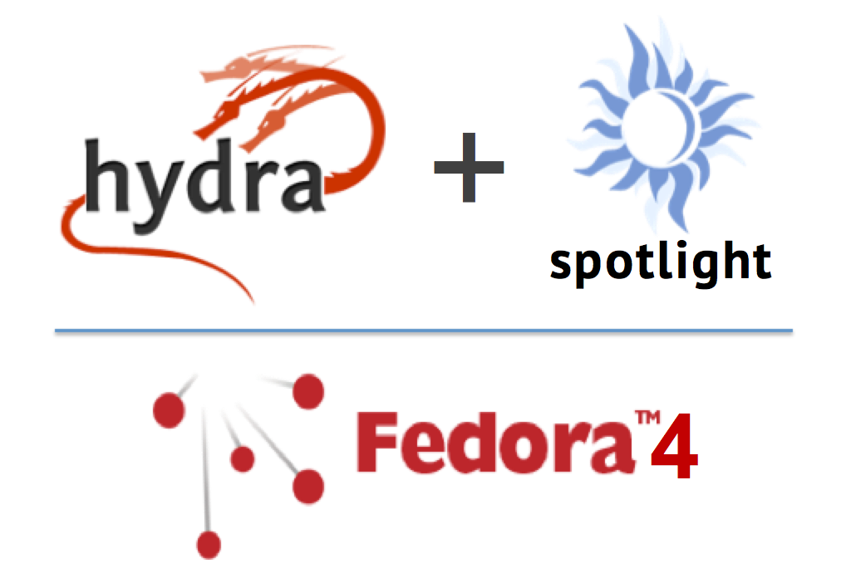






UVic Digital Asset Management Systems
Notes:
I realised that digitized content at UVic is actually distributed across at least nine platforms and systems, and these are just the ones that I know about. Chances are that the figure we reported was not entirely accurate.

Slide 9
CARL 2018 Digital Preservation Survey
Most respondents do not have adequate staff devoted to digital preservation. (p. 16)
Few organizations have the equivalent of a full time individual for digital preservation, and fewer still have any one person with a sole responsibility towards preservation. (p. 22)
Notes:
Part of the reason that we can’t provide accurate reports, and we don’t have policies in place, is because we don’t have enough staff dedicated to the problem of digital preservation.
http://www.carl-abrc.ca/wp-content/uploads/2018/12/CARL-DPWG-Survey-Phase1Report.pdf
http://www.carl-abrc.ca/wp-content/uploads/2018/12/CARL-DPWG-Survey-Phase2-Report.pdf

Slide 10


Programmers
Digital Preservation Librarian
Data Curation Librarian
Head of Systems +
Head of Metadata
AUL Digital Scholarship, Archivists, Schol Comms Librarian, Digitization Staff

Slide 11

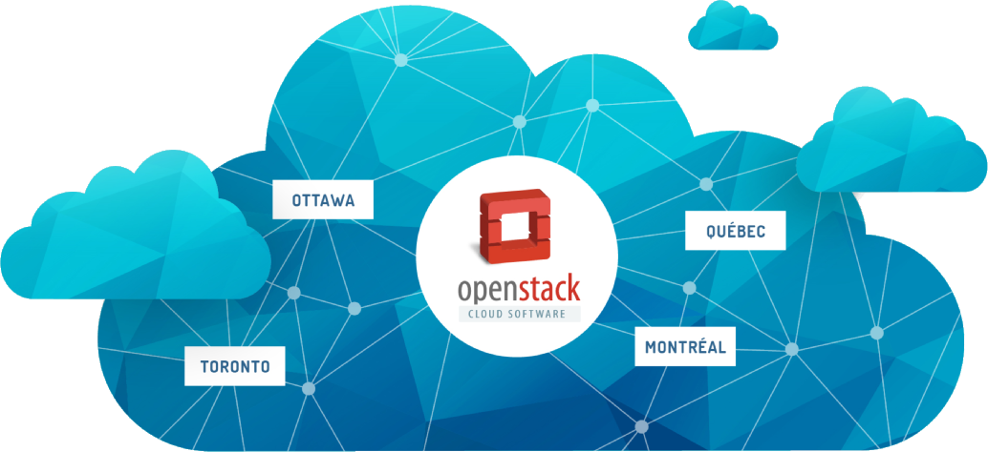

Local Digital Asset Management
http://vault.library.uvic.ca
Notes:
A lot of local effort is going in to a migration of our digitized collections from ContentDM to our new Samvera system. Samvera is built on the Fedora Commons repository platform, which can help us move towards a more OAIS-compliant workflow.
Fedora 4 generates checksums on each files, and enables periodic auditing of file integrity.
By implementing best practices locally, we can ensure that our digital files carry with them all of the needed information for preservation and reuse in other contexts.
-------------------
Fedora Commons can generate checksums on files for the system to perform fixity check, which indicates whether a file has been tampered with; the Islandora Checksum and accompanying Checksum Checker modules allow Islandora administrators to enable checksum generation and to configure how often regular file integrity audits (i.e., fixity checks) are performed. If an audit detects a file integrity problem, the discrepancy is logged and the administrator is notified.

Slide 12
Digital Preservation: Campus Partnerships
Notes:
Digital preservation is a huge opportunity for libraries. We are the only group on campus who are thinking about preservation and access on timelines of 50 or 100 years. Campus IT does not think that way, nor does Research Computing. This work has always been core to the mission of libraries and archives.
It is absolutely critical that we articulate this expertise to our administrators and faculty. Digital preservation is a fundamental aspect of the ongoing value of libraries in the digital world.

Slide 13
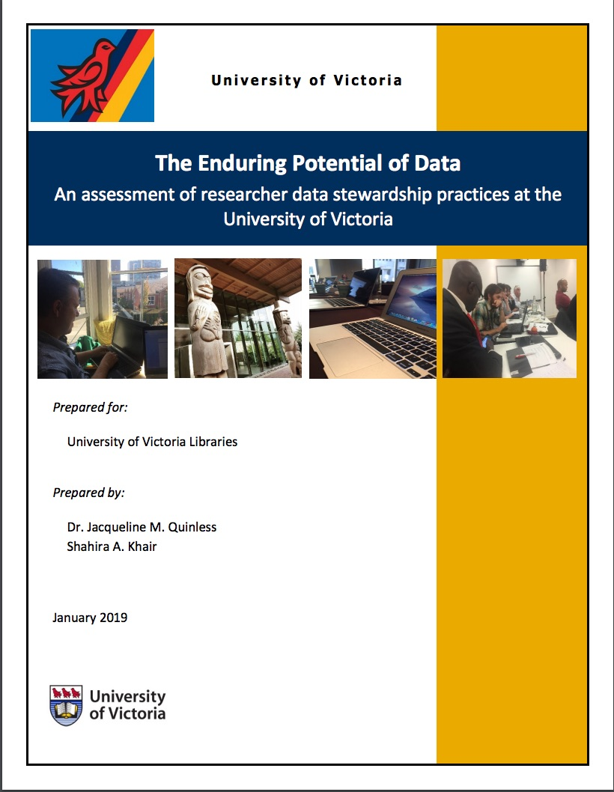
Campus RDM Survey
Survey responses from 420 faculty members and graduate students.
Identifies the major areas of challenge for researchers.
Recommends strategies for the library and for the university.
Notes:
Canada has lagged a little bit in the RDM space, but our funding agencies are finally implementing mandates, so many folks on campus are suddenly very interested in this issue.
Two years ago we were fortunate to have a CLIR data fellow, and she conducted a campus-wide RDM survey.
The resulting report was an excellent way to signal our expertise and leadership to campus stakeholders. It gave us a foot in the door to talk to faculty and administrators about the role of the library in RDM.
Our Research Computing group was able to use our data to help argue for more storage funding.
https://dspace.library.uvic.ca/handle/1828/10509

Slide 14
UVic RDM Committee
Develop an institutional strategy for research data management:
Research Office
Libraries
CIO
Research Ethics Board
Privacy Office
Notes:
The library has built a reputation as critical RDM partner, and we are now involved in developing a university wide RDM strategy.

Slide 15

The Endings Project @ UVic
Concluding, Archiving, and Preserving Digital Projects for Long-Term Usability
SSHRC Insight Grant
$192,000
4 Years
Notes:
There is so much faculty need beyond just support for mandated data deposit. Faculty research projects generate a huge number of digital objects and tools, and only rarely is there a sustainable preservation plan in place.
UVic Libraries have partnered with faculty from several Humanities disciplines on a funded project called the Endings Project.
How do digital humanities projects conclude?
How should they conclude?

Slide 16
Endings Project - Preliminary Results
“I’m trained to be a researcher, not an archivist.”
Of 127 projects spanning 30 years:
25% are considered to be “complete”
10% have reliable long term archiving in place
PIs want to follow best practices but are not trained, and institutional support is limited.
A number of researchers approached their libraries, but were turned away.
Notes:
Survey of DH project leads: 127 responses
In-depth interviews: 27

Slide 17
Grants Menu – Faculty Partnerships
Clearly outlines in-kind value of library services for faculty grant applications.
Digital Asset Management
Metadata Expertise
Long Term Preservation Services

Slide 18
Digital Preservation: Regional Partnerships
Notes:
While campus partnerships are absolutely critical, they tend to create a lot more work for us.
Regional and national partnerships, on the other hand, help us to get that work done in a sustainable way.

Slide 19
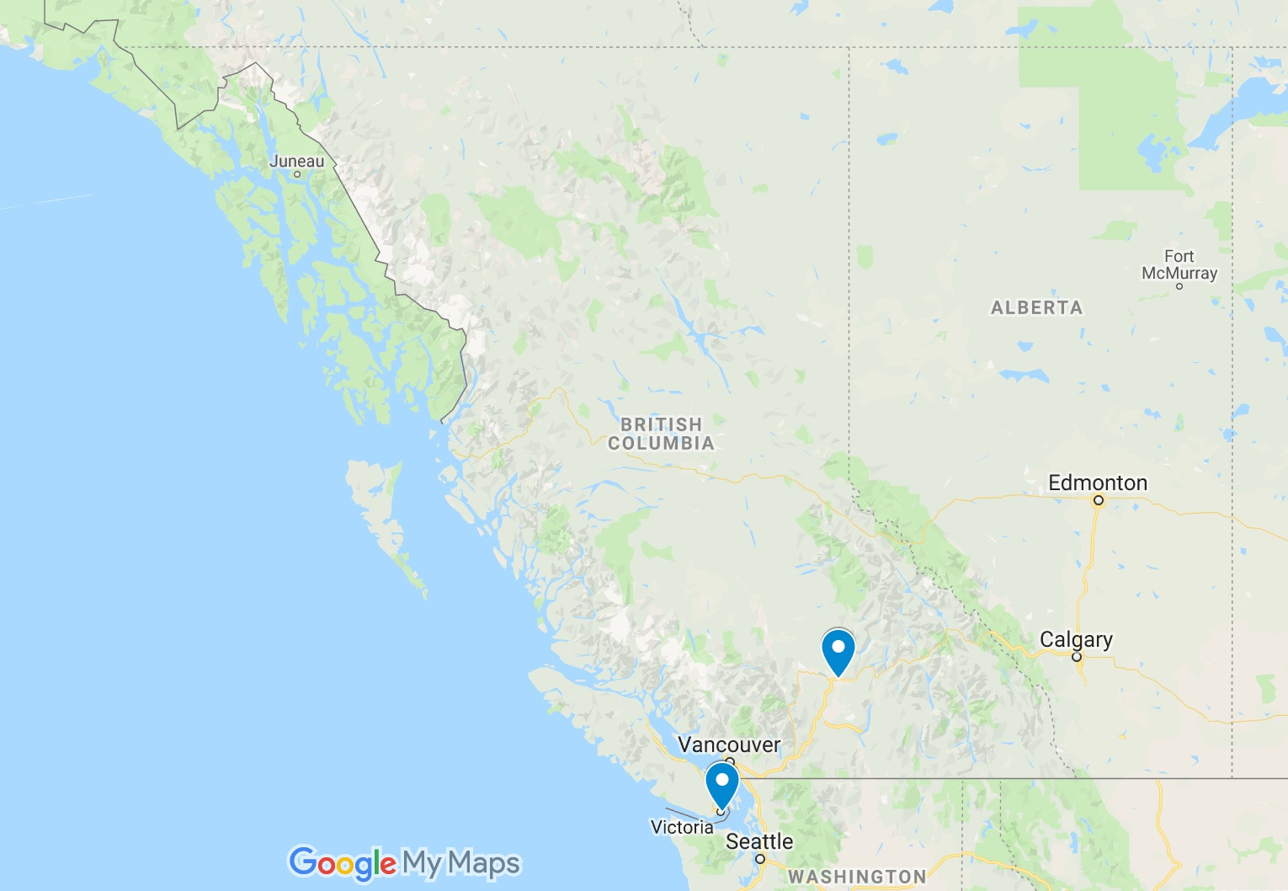
BCNET Data Backup Service
Notes:
One unique risk factor at UVic, is that our region will, at some point, suffer a devastating earthquake. This means that we absolutely can’t keep our digital surrogates on campus along with our unique collections.
Fortunately, we have BCNET, an organization that provides IT infrastructure to Universities in British Columbia. We are currently negotiating regular backups of our digital collections to an offsite storage facility in the interior of BC. This isn’t monitored archival storage, but it is a good first line of defense against data loss.

Slide 20
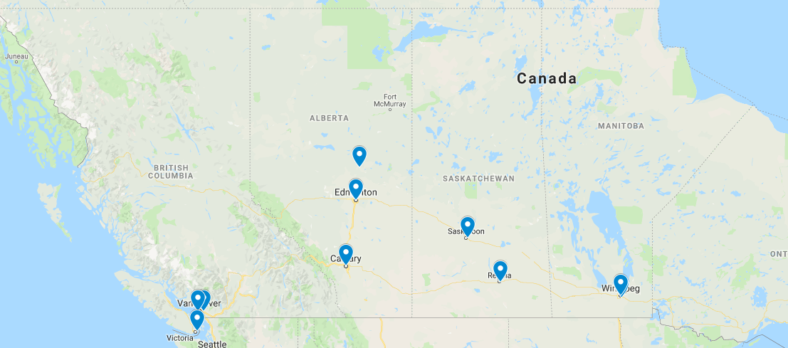
COPPUL WestVault LOCKSS Network
Five distributed copies of files.
Automated integrity checks.
Notes:
UVic is also a member of COPPUL, a consortium that brings together university libraries in the western provinces of Canada. COPPUL has developed WestVault.
Problem: LOCKSS is expensive because 20TB of data becomes 100 TB of storage. We have therefore opted to put only our most critical resources into WestVault – our ETDs as per our DP policy.
https://coppul.ca/pln

Slide 21
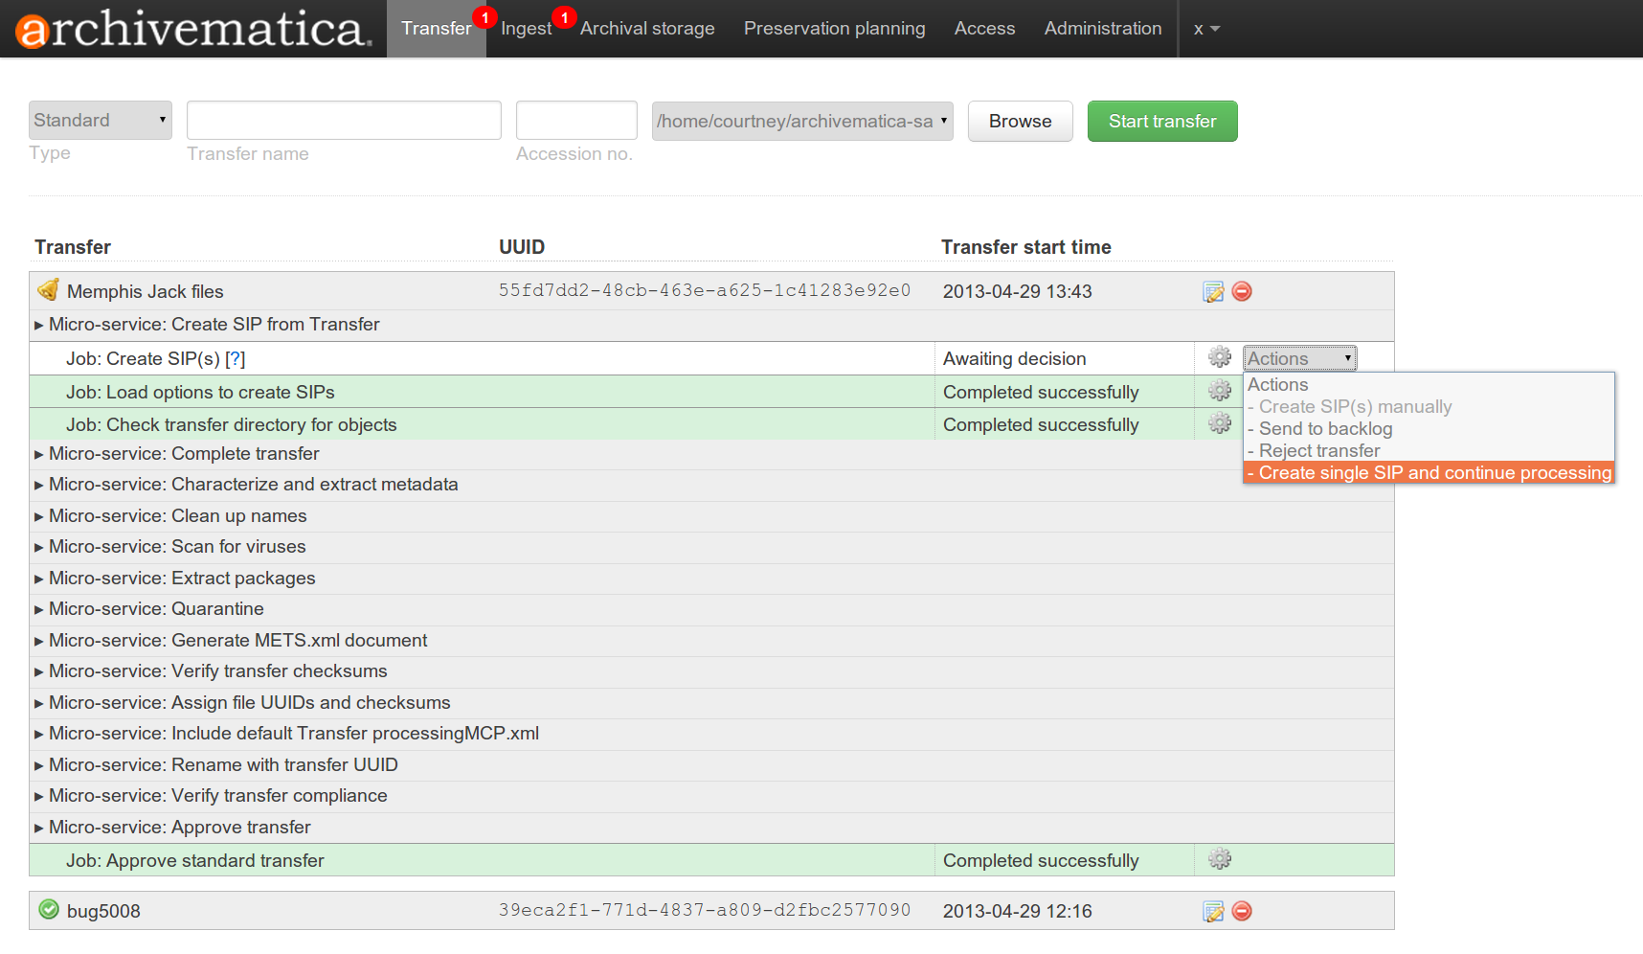

Archivematica As a Service
Notes:
COPPUL has also been instrumental in creating shared services around preservation processing. UVic is one of several partners in the Archivematica service that is hosted at UBC.
Files and metadata from the digital asset management system are ingested into Archivematica where they are enhanced with preservation metadata and packaged into Archival Information Packages (AIPs) using the BagIT standard.
These AIPs can then be sent to LOCKSS or other long term storage solutions.
Prevents every library from running its own local version of Archivematica. Contract ensures that our shared version is always up to date.
Archivematica software packages files and metadata into OAIS-compliant Archival Information Packages for long term storage.
--------
Archivematica is an integrated suite of software tools that allows users to process digital objects from ingest to access in compliance with the ISO-OAIS functional model.
Content Information (Content Data Object and Representation Information), Preservation Description Information (Reference, Context, Provenance, Fixity, and Access Rights Information), Packaging Information, and Descriptive Information – collectively form the
information model of an OAIS-type archive.
BagIt is a file packaging specification jointly developed by the US Library of Congress and the California Digital Library.
The Archivematica digital preservation system uses BagIt to create AIPs.

Slide 22
Digital Preservation: National Partnerships
Notes:
Finally, lots of good work is happening at the national level. Although Canada is geographically huge, we have a relatively small number of people and universities, so collaborating nationally makes sense, and is fairly easy.
National partnerships help to compensate for staffing shortfalls at the local level.

Slide 23
Canadian Web Archiving Coalition
Coordinates web archiving among university libraries
Ensures that critical national & regional content is captured
Develops long term strategy for preserving content in ArchiveIT
Notes:
CWAC coordinates collection policy around web archiving. Particular focus on government information at the provincial and municipal levels. Ensures that we are preserving as much as possible with limited resources.
CWAC is also concerned with repatriating copies of WARCs held at the Internet Archive. We love the IA, but we don't know if it will be around in a hundred years.
http://www.carl-abrc.ca/advancing-research/digital-preservation/cwac/

Slide 24
CARL Digital Preservation WG
Collects data & tracks DP progress among memory institutions
Organizes knowledge sharing & training events
Notes:
The group that administered the survey that I've been citing throughout this talk.
http://www.carl-abrc.ca/advancing-research/digital-preservation/

Slide 25
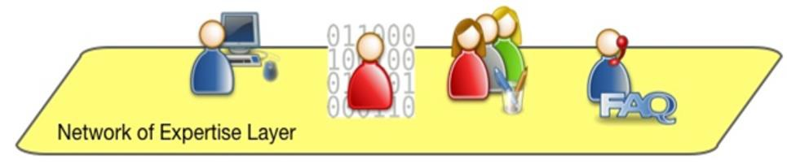
Portage Network of Experts
Pan-Canadian Research Data Management expertise with over 100 in-kind experts
Preservation Expert Group
Curation Expert Group
Repositories Working Group
Dataverse North Working Group
Notes:
Portage is CARL’s research data management arm. Although it consists of only a few fulltime employees, it has been very successful in mobilizing Canadian expertise. More than 100 librarians in various groups creating reports, standards, policy, and infrastructure.
Some of the relevant expert groups include: see slide

Slide 26
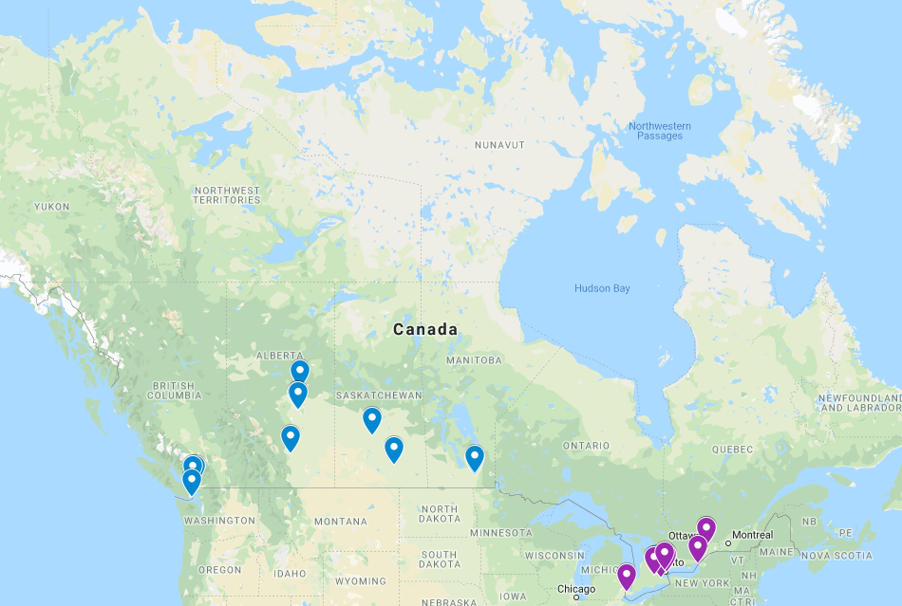
COPPUL WestVault
Ontario Library Research Cloud
Notes:
CARL/Portage are in a good position to knit regional efforts together into national infrastructure. For example, we have the WestVault LOCKSS network in the West, and the Ontario Library Research Cloud in the east. With the right governance initiatives these could become a strong basis for a national preservation storage network.
The work of these groups is important in generating information that can influence national policy and funding.
Canada needs a coordinated preservation program with core activities that support research data preservation nationally. Creating a distributed OAIS-compliant preservation network is crucial to the long-term preservation of research data in Canada.
PEG Whitepaper, 2018
https://portagenetwork.ca/wp-content/uploads/2018/05/Portage-PEG-WhitePaper-EN.pdf

Slide 27
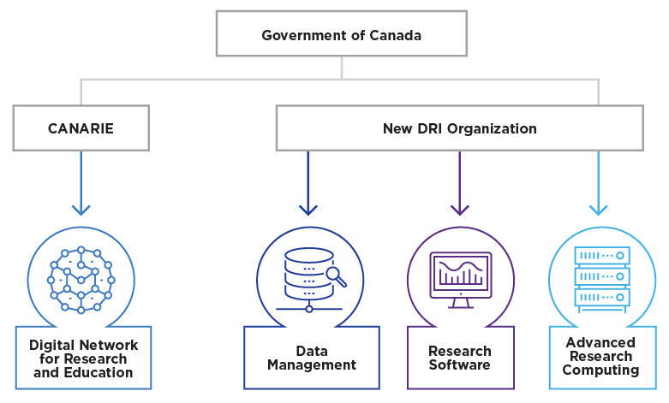
Digital Research Infrastructure Funding
$572.5 million
Notes:
CARL/Portage have been extremely important voices representing libraries in broader national conversations around research infrastructure. It is in no way a given that governments and IT providers will understand the role of libraries as partners unless we are able to clearly articulate our value.
https://www.ic.gc.ca/eic/site/136.nsf/eng/home

Slide 28
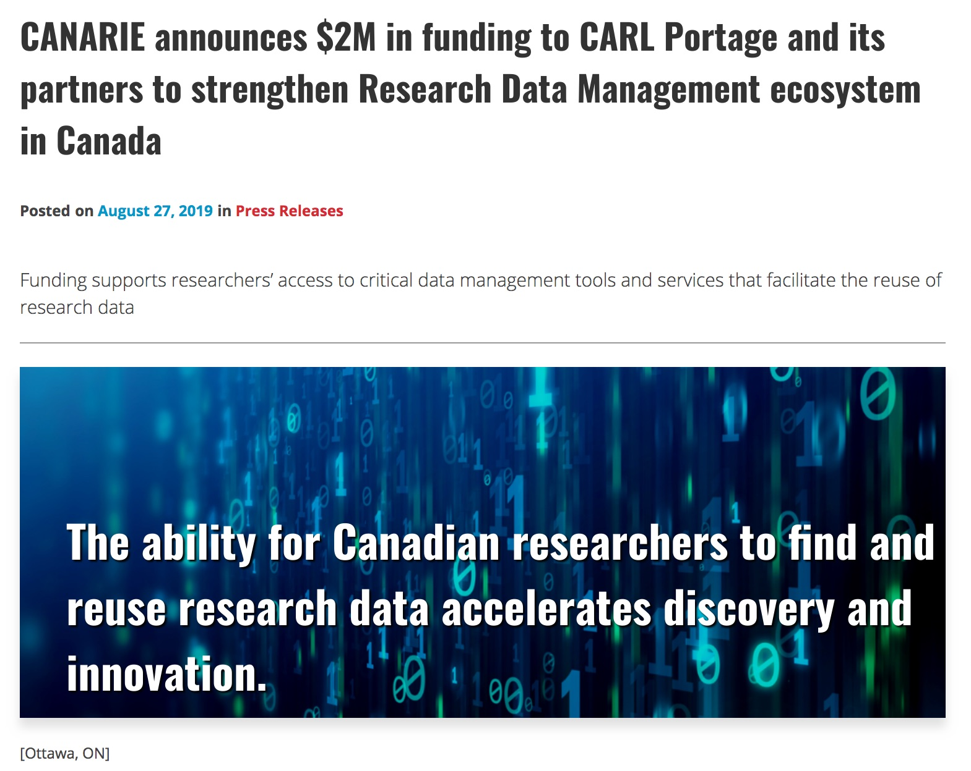
Notes:
Measure of success. New funding announced just last week.
https://www.canarie.ca/canarie-announces-2m-in-funding-to-carl-portage-and-its-partners-to-strengthen-rdm-ecosystem-in-canada/

Slide 29


Digital Preservation: Future Work
Storage
Expertise
Funding
Distributed, replicated
cloud storage with audit tools.
Dedicated professional positions at
local and national level
Ongoing, long-term funding model.

Slide 30







New Partnerships
?
Notes:
Think internationally. Think cross-sector.

Slide 31
Thank you. lgoddard@uvic.ca

